Slide 1
Notes:
Blockchain and AI enabled business models joke

Slide 2

New Ideas: Not Your Grandma’s
Non-Dues Revenue
with
Teri Carden
Ideator and Chief Bear Poker
Presenter does not have any financial conflicts to report at this time.
Notes:
The capacity to learn is a gift, the ability to learn is a skill and the willingness to learn is a choice.
Today’s format.
Learning Objectives:
Obtain a clear understanding of why organizations should keep reinventing non-dues revenue opportunities
Articulate the business case and strategies for implementing the five non-dues revenue concepts
Gain insights from organizations already earning revenue using these new concepts

Slide 3

The Challenge
Raising Dues Isn’t a Pleasant Option
Where to Start
What Resources are Needed
A New Expectation on Buying is Here
Notes:
Membership dues alone are not enough to keep most associations afloat, on average they make up only 39% of an association’s total revenue. On the other hand, 61% of an association’s total revenue is non-dues revenue.
According to ASAE Foundation’s Association Operating Ratio Report (2016) they’ve dropped from 95.7% in 1953 to 45.4% for trade associations and 30% for professional societies.

Slide 4
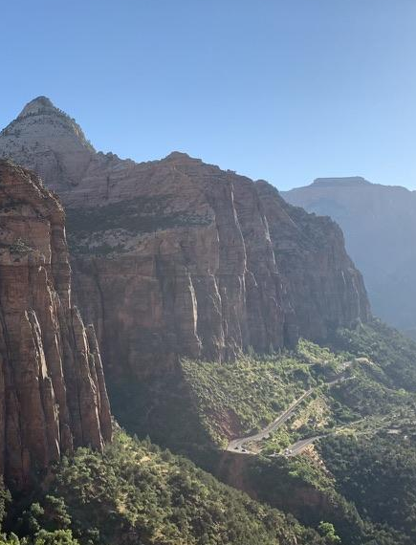
Royalty and Affinity Programs
Advertising and Sponsorships
Education and Events
Products and Services
Current Landscape of Non-Dues Revenue
Notes:
Royalty/Affinity Programs: These programs are typically products or services that members need in their business or personal lives. They include discounts on office supplies, car rentals, and an array of insurance products like professional liability, health, and automobile. The association usually receives royalties on the money their members spend on these programs. These royalties are given in exchange for promoting the program and licensing their brand assets to the affinity partner.
Advertising/Sponsorships: Whether for events, printing, website banner advertising, or selling naming rights to an association’s conference rooms, many organizations rely on advertising and sponsorships for non-dues revenue. This line of business has grown. Associations can now outsource advertising and sponsorship sales to businesses specializing in association sponsorship sales.
Education/Events: Most associations rely on profits from events and education to help drive their budget. Years ago, it was more common for association events to just cover their costs. Nowadays, most associations expect their conferences and educational programs to turn a profit and contribute positively to the bottom line.
Products/Services: Some associations sell physical goods such as books, manuals, logo-wear, and other swag. Others offer services to members and prospects such as consulting and other professional services.

Slide 5
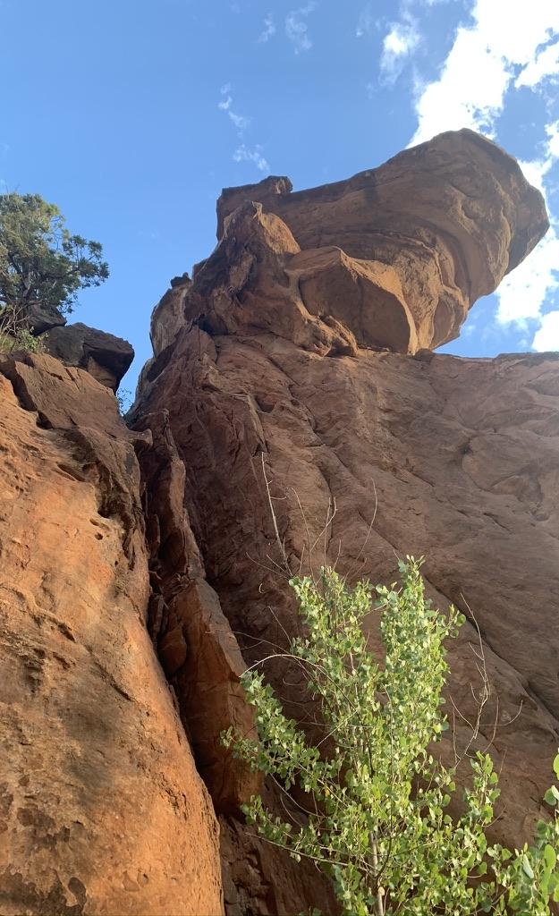
What’s New In the World of Non-Dues Revenue
Consulting Services
Corporate Sponsorships (DEI)
Career Assistance & Univ Partnerships
Accelerator Programs
Market Intelligence
Mergers & Acquisitions
Reimagined Affinity Programs
Notes:
Same Ideas but Monetizing It
Social media – you’re already doing it – why don’t you offer a sponsor a slot or give them your audience for a day.
What’s New?
New Product Ideas >> spinning up for-profit entities
Consulting
Accelerator Programs (Independent Community Bankers of America developed an accelerator program that helps community banks directly engage and partner with early-stage or startup companies focusing exclusively on community bank product development.)
Mergers & Acquisitions
Market Intelligence
Selling market intelligence is another good source of non-dues revenue for your association. A report by Avenue M Group found that 25% of associations derive revenue from benchmarking data and 19% earn revenue from selling market intelligence.

Slide 6
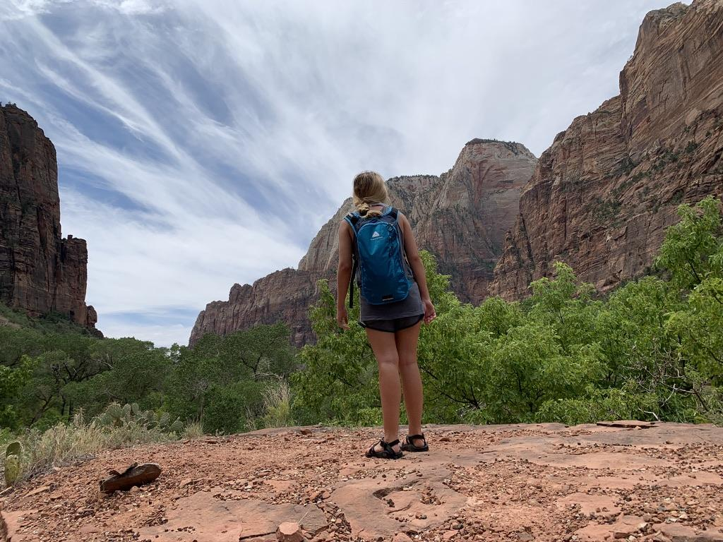
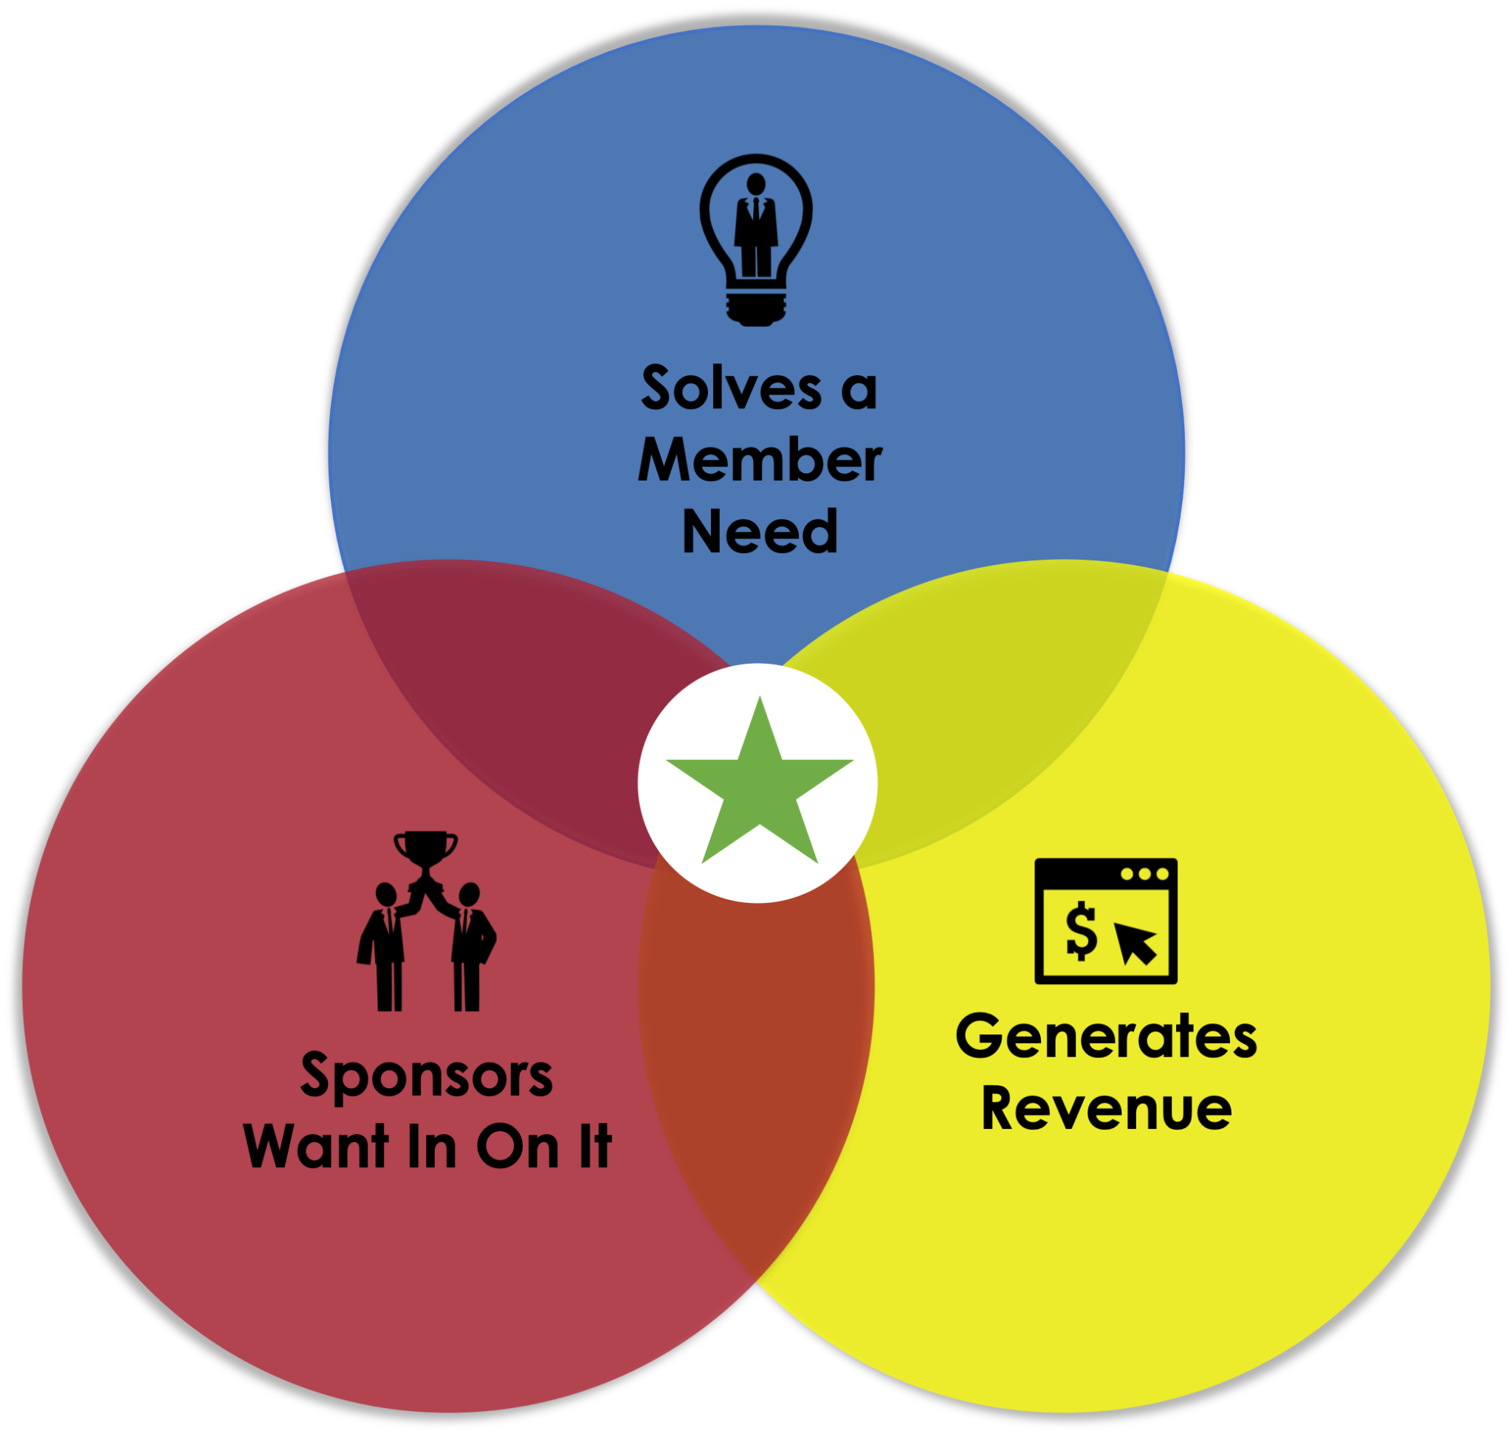

THE BEST REVENUE IDEAS
Notes:
Where the best ideas come from… concentric circles/ven diagram

Slide 7
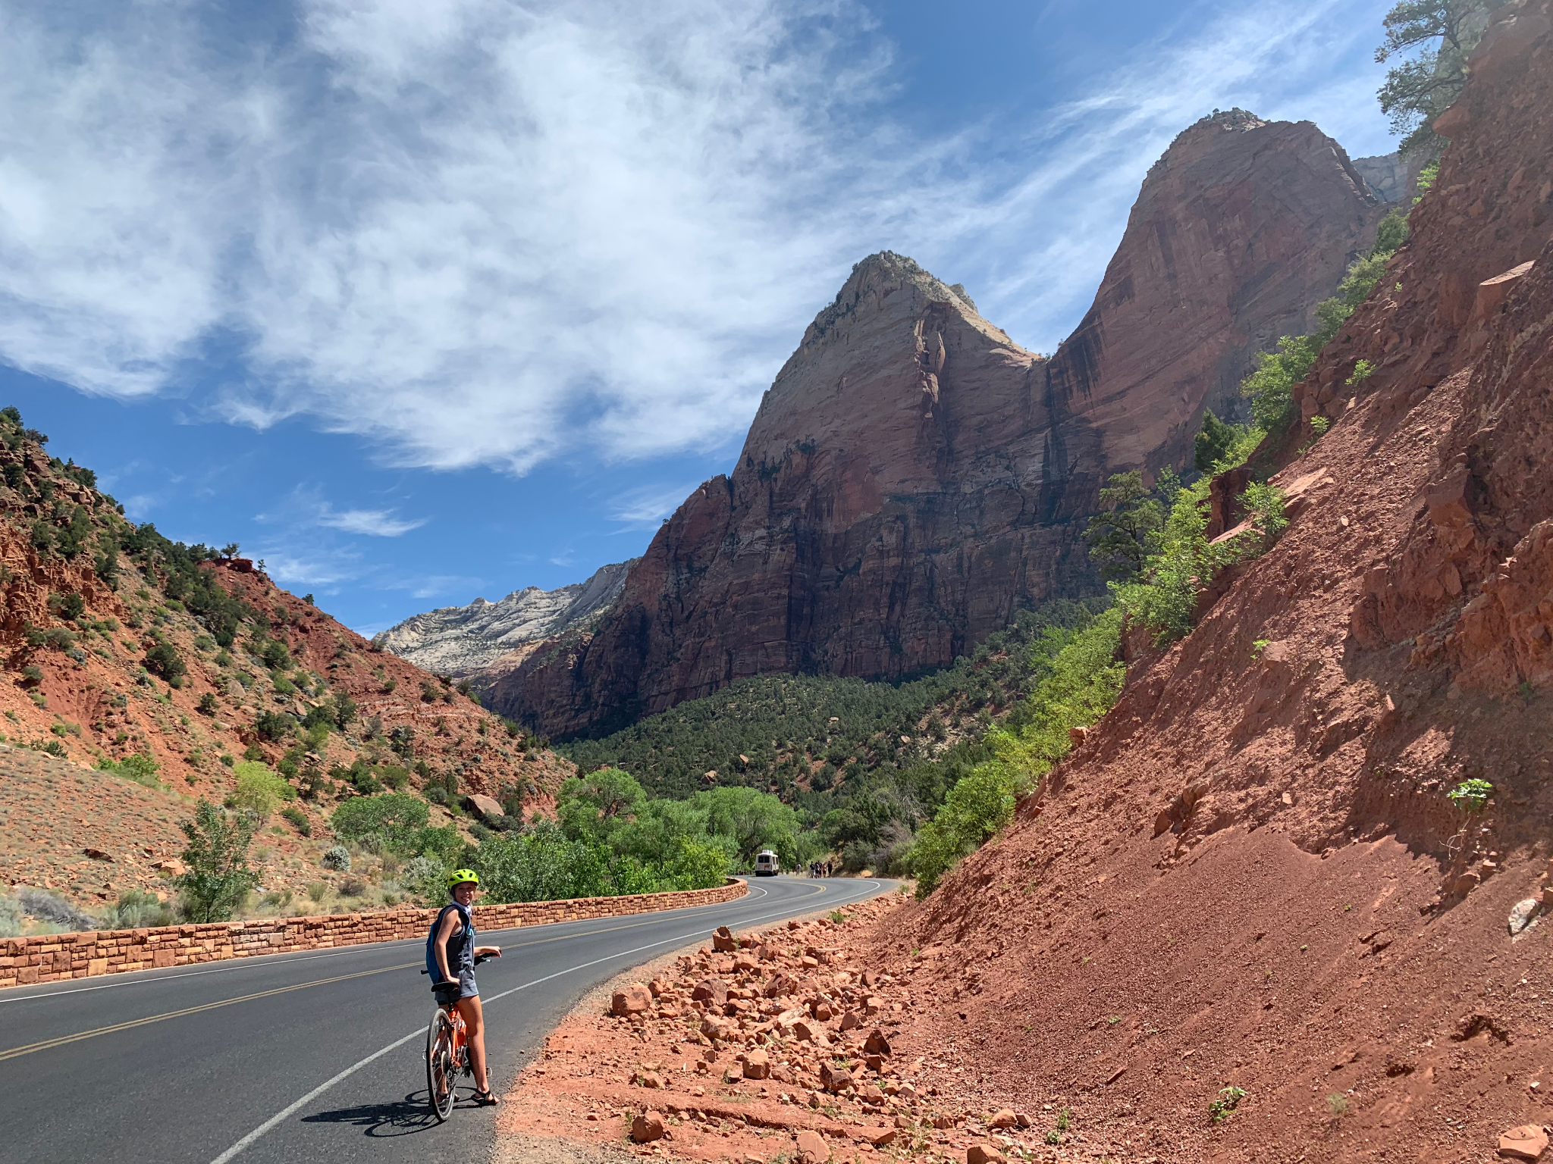
Motives for New Ideas
Anecdotal Interest
Trends Spotted by Board
Volunteer Passion
Necessity for Budget
Sessions Like This One
Notes:
Motives:
Anecdotal member interest,
board-member beliefs, and volunteer passion
are all examples of how product-development
decisions may be driven in associations

Slide 8
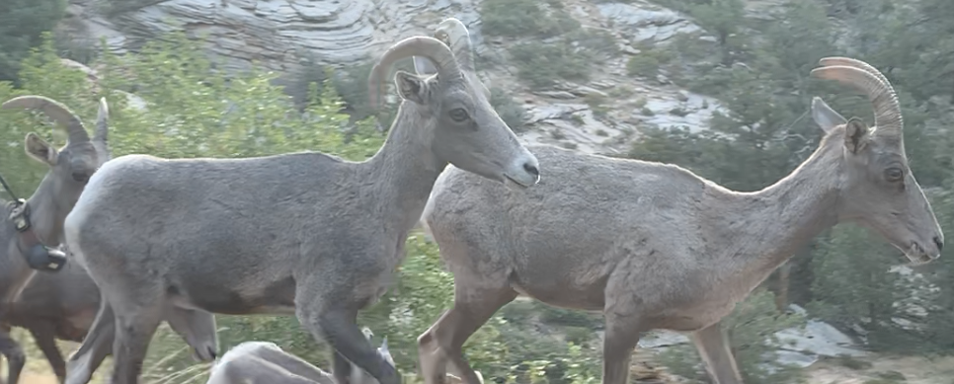
How This is Going to Work
Notes:
Format for today’s ideas…
Present the idea
Share a case study
Discuss 1-5 stars on level of effort

Slide 9
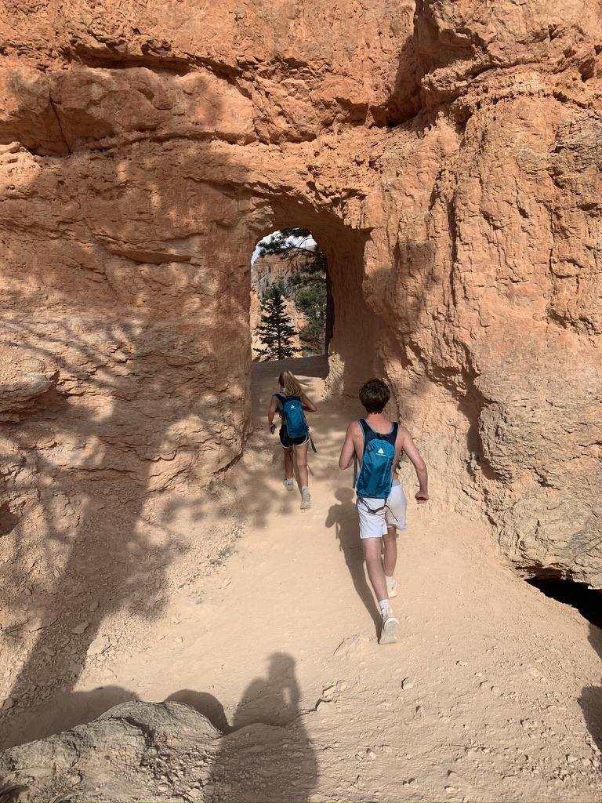
#1 SPONSORED RETARGETING
Retargeting the sponsor’s ad to the visitors of your website.
Notes:
Feathr
Facebook, google ad sense, amazon – retargeting tools
Pay per click OR pay per view –
Important to ask vendors what they would be willing to pay per lead
Laws around dropping cookies and users accepting terms and GDPR so make sure you’re up on those.

Slide 10
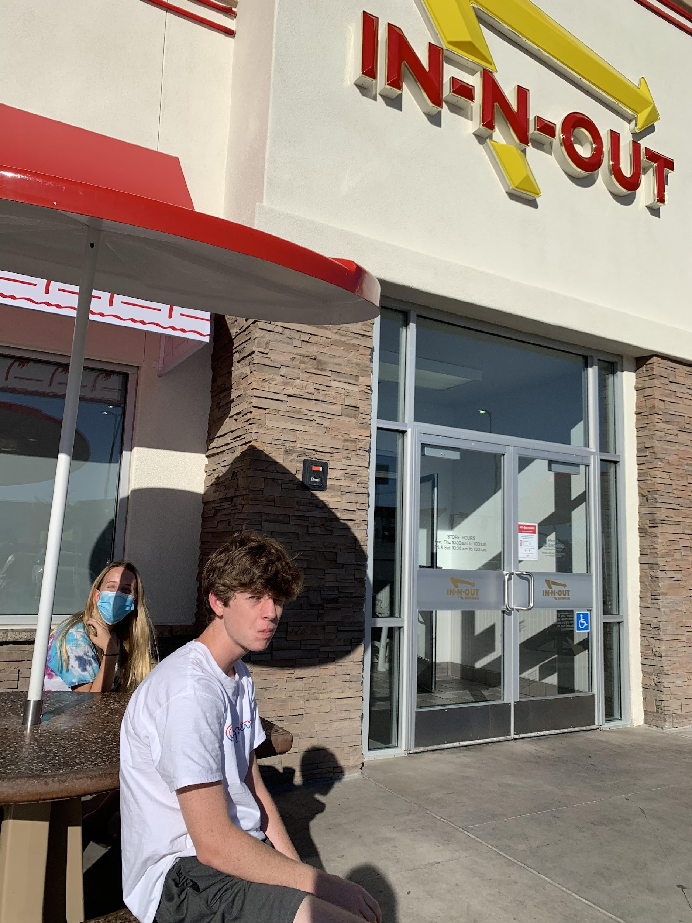
CASE STUDY:
GLOBAL BUSINESS
TRAVELERS ASSOCIATION (GBTA)
Notes:
Hyatt
Mastercard
Amtrack
Sold Retargeting for $1 per impression and in blocks of 5,000-10,000

Slide 11
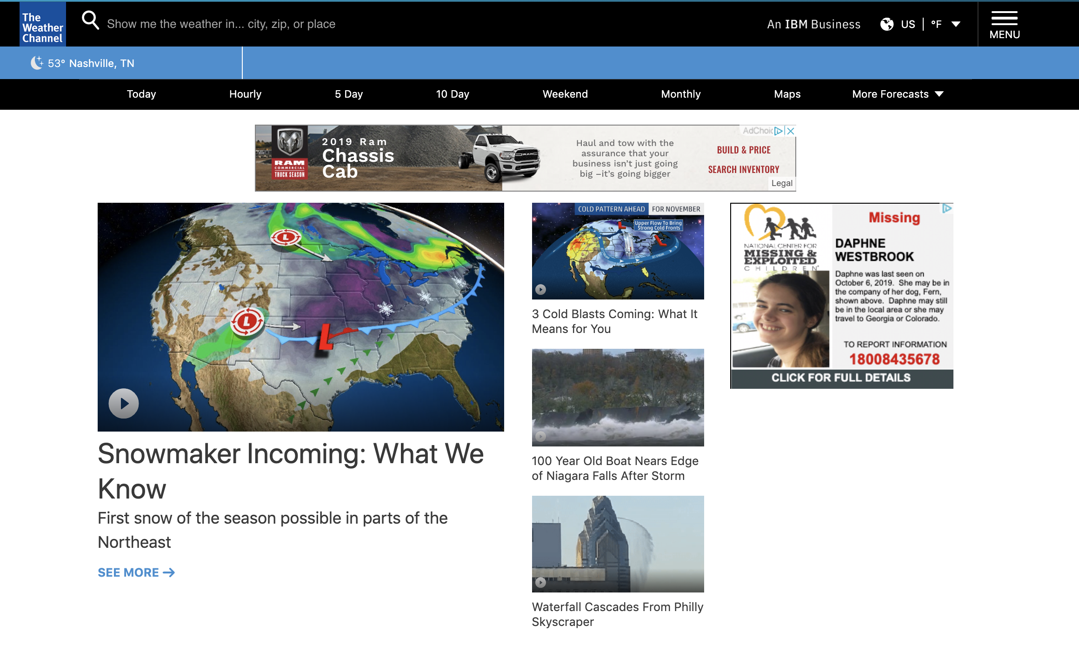

Notes:
Hyatt
Mastercard
Amtrack
Sold Retargeting for $1 per impression and in blocks of 5,000-10,000

Slide 12

LET’S TALK:
SPONSORED RETARGETING
LET’S TALK:
SPONSORED RETARGETING
What is the staff intensity
of this initiative?
1 = Low Intensity
5 = High Intensity

Slide 13
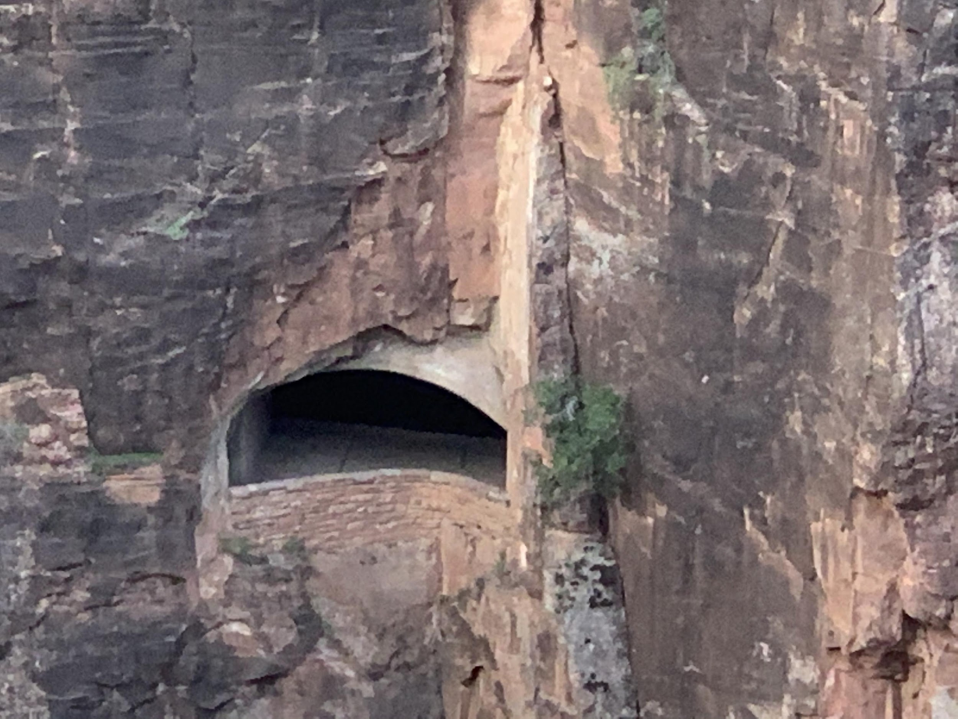
#2 NAMING RIGHTS
An existing service or product within an organization that can be sponsored and marketed by a brand.
Notes:
Who has done a digital asset audit in the last 12-18 months? What’s your most loved digital asset?
Much like we have sponsored badges, we can have sponsored products or services, too.
Think virtual zoom rooms
Think online community groups
Section of the website?
VAR example

Slide 14
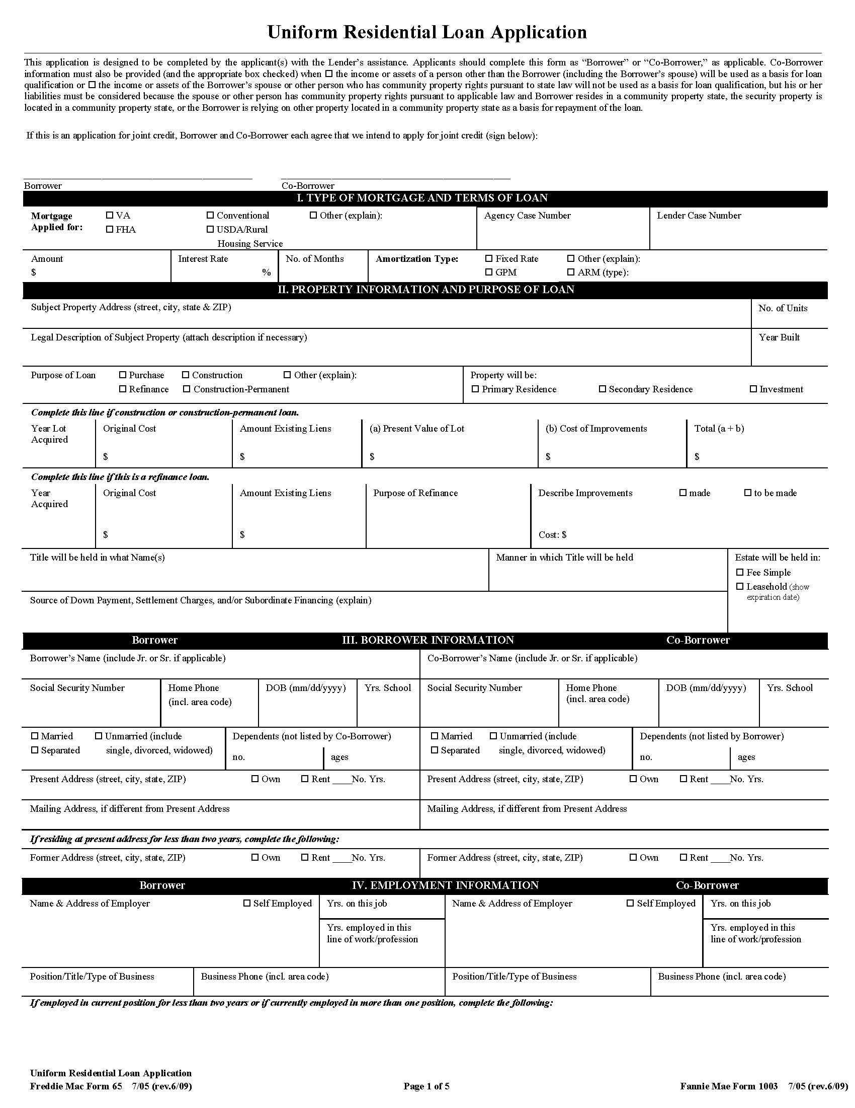
CASE STUDY:
VIRGINIA ASSOCIATION
OF REALTORS (VAR)
Notes:
VAR Forms

Slide 15

LET’S TALK:
NAMING RIGHTS
What is the staff intensity
of this initiative?
1 = Low Intensity
5 = High Intensity
Notes:
Risk and Reward: 2-3 stars (because of the political nature of a brand that might be a competitor)

Slide 16
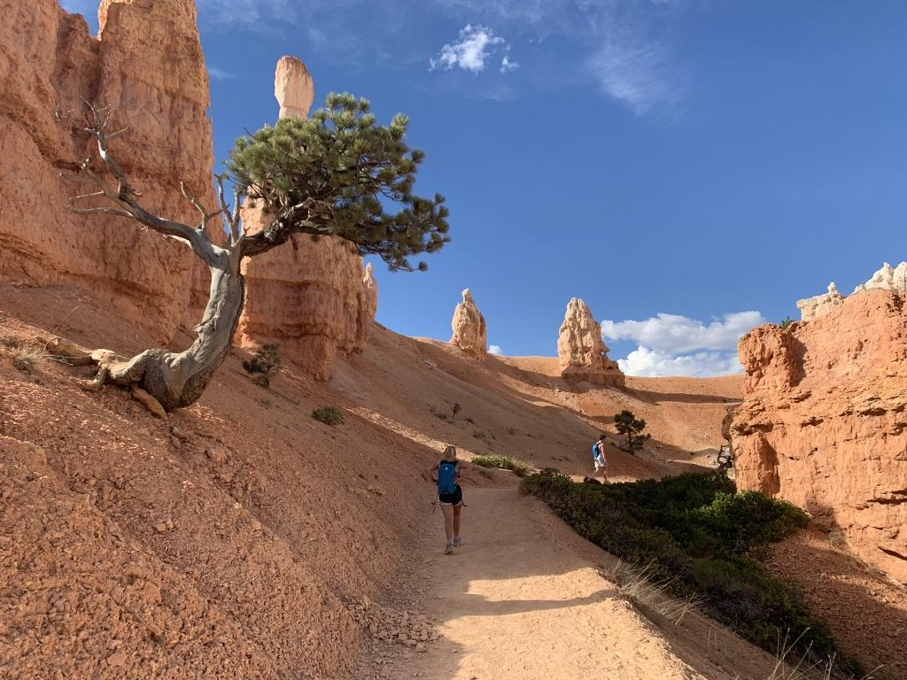
#3 SPONSORED POLLS
Questions or polls generated by sponsors for a period of time with the results being provided after poll/question is closed.

Slide 17
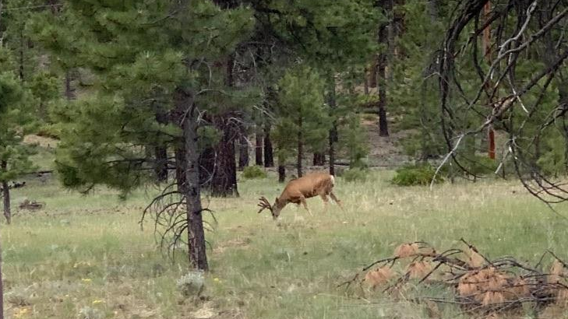
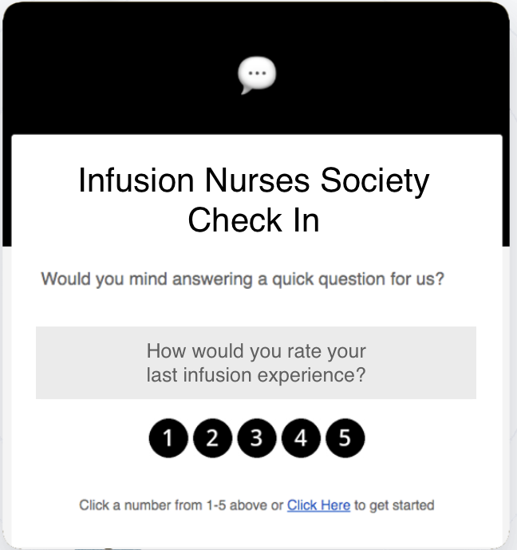

CASE STUDY:
INFUSION NURSES SOCIETY
Notes:
Sponsored Polls

Slide 18
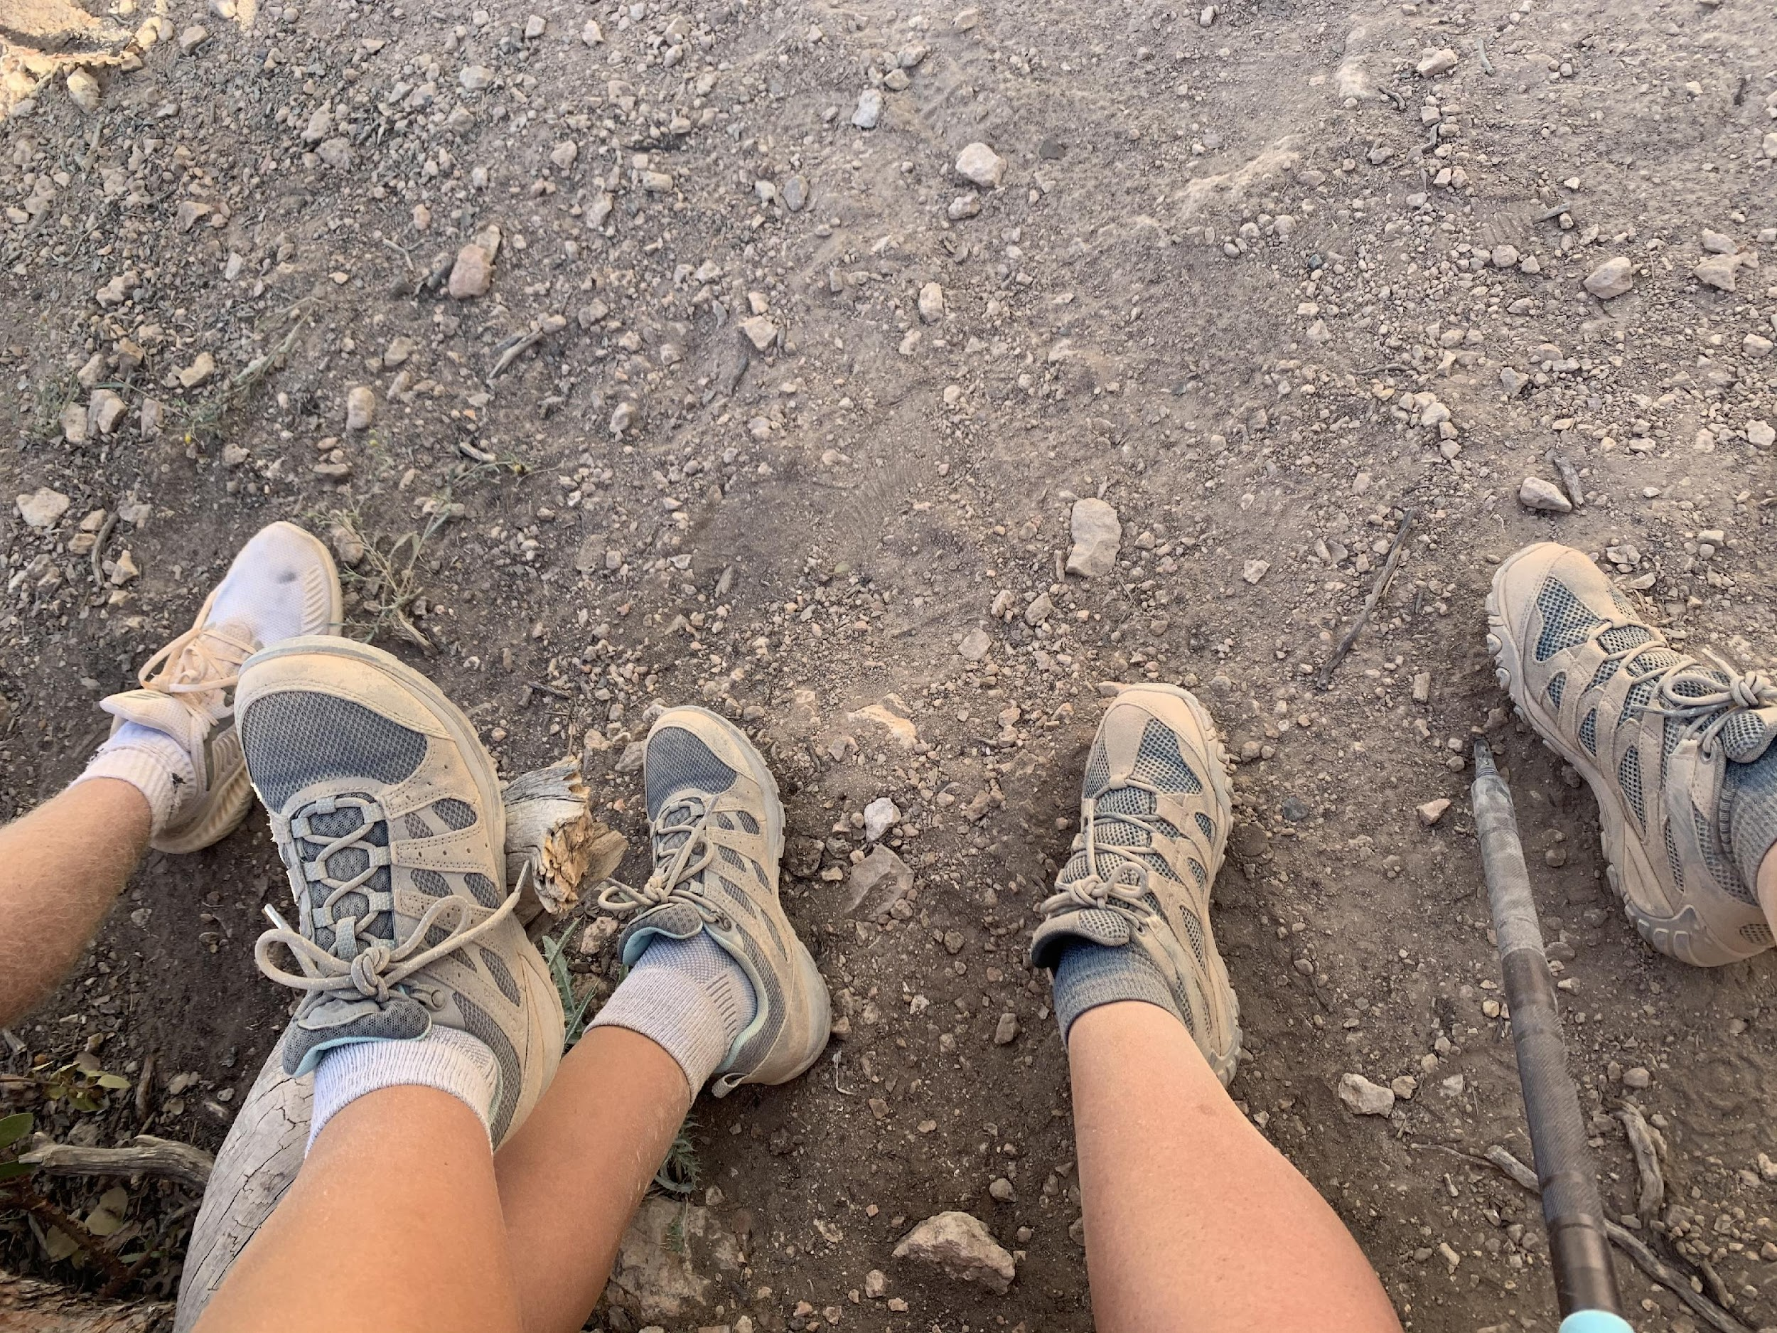
LET’S TALK:
SPONSORED POLLS
What is the staff intensity
of this initiative?
1 = Low Intensity
5 = High Intensity
Dave Will
dave@propfuel.com
Tell him I sent you ;)
Notes:
Risk and Reward: 2 stars

Slide 19

#4 COHORT OR SOLUTION SITS
Sponsor Observed Discussions

Slide 20


CASE STUDY:
Sponsor: Naylor
$800
5 Meetings
5 Months

Slide 21
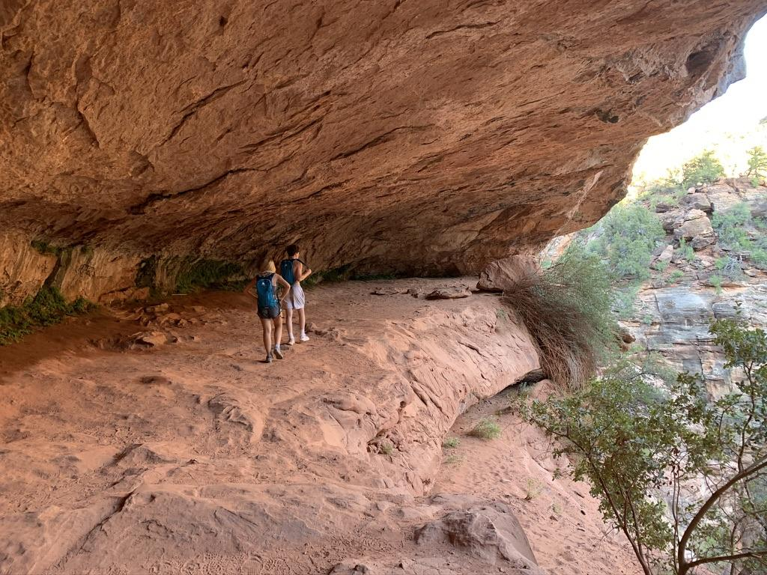
HOUSE RULES FOR COHORTS
What happens in the cohort, stays in the cohort.
No homework zone unless you assign it to yourself.
Commit and do your best to attend each of the meetups.

Slide 22
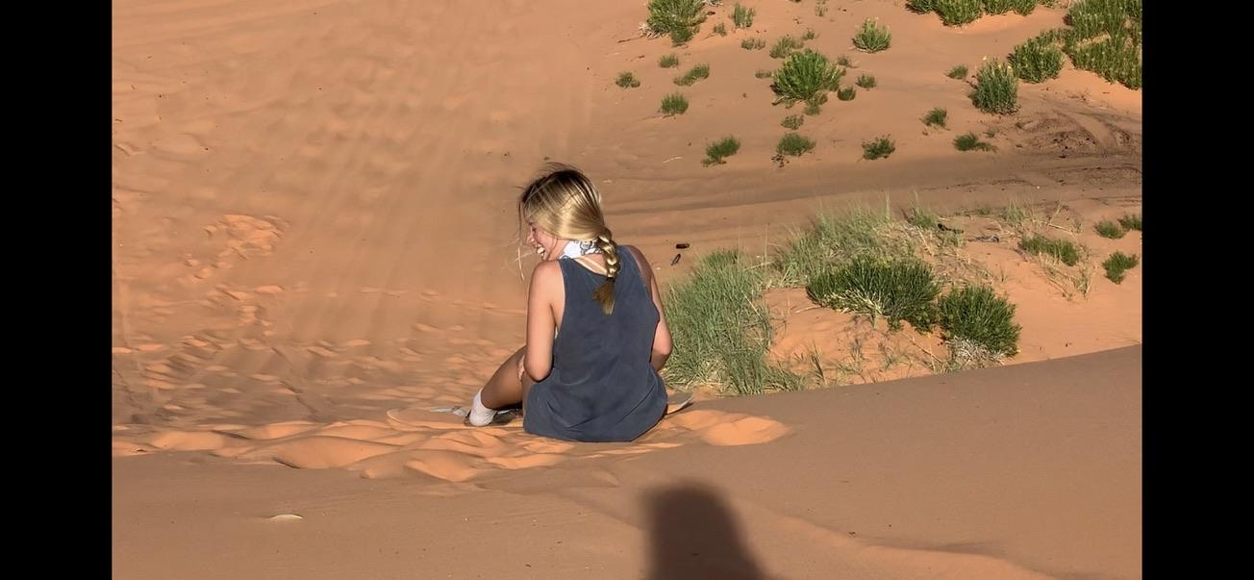
LET’S TALK: COHORTS
What is the staff intensity of this initiative?
1 = Low Intensity
5 = High Intensity

Slide 23
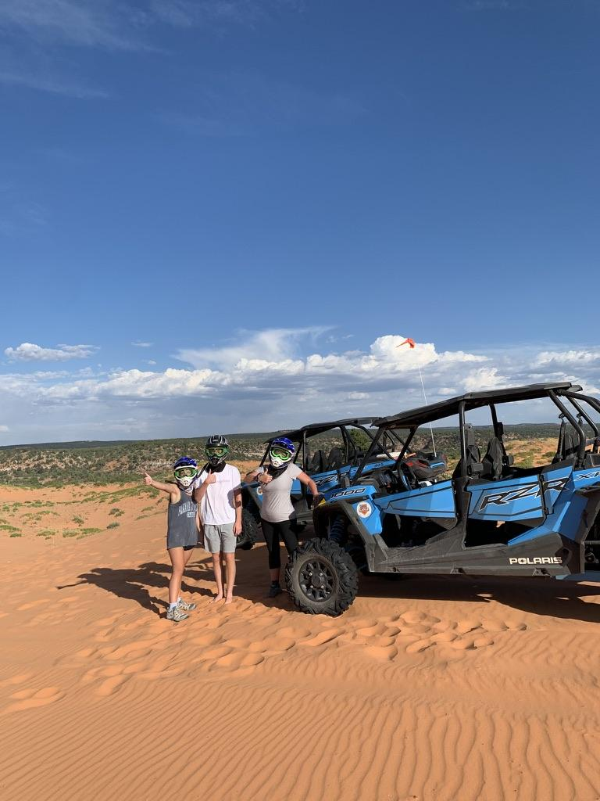
#5 POPUP LIVE AUCTION
A live auction experience to bring more traffic to participating booths, build more excitement on your show floor, generate more sponsor revenue and grow your giveback program.

Slide 24
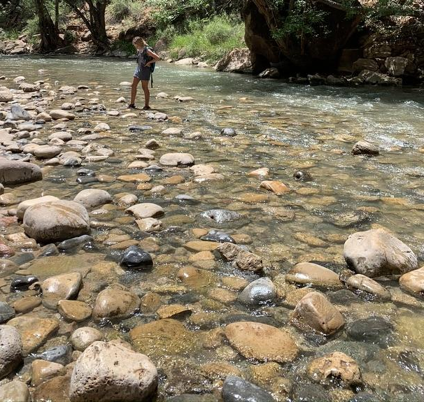
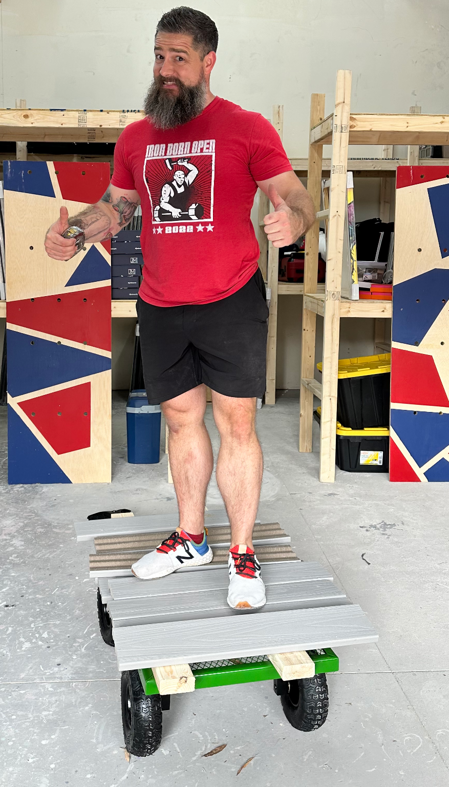

CASE STUDY:
WHO WILL BE THE FIRST CASE STUDY?
Tony Rissley
tony@expoauctions.com
Tell him I sent you ;)

Slide 25
LET’S TALK:
POP UP LIVE AUCTIONS
What is the staff intensity
of this initiative?
1 = Low Intensity
5 = High Intensity
Notes:
Staff Intensity: 2 stars

Slide 26
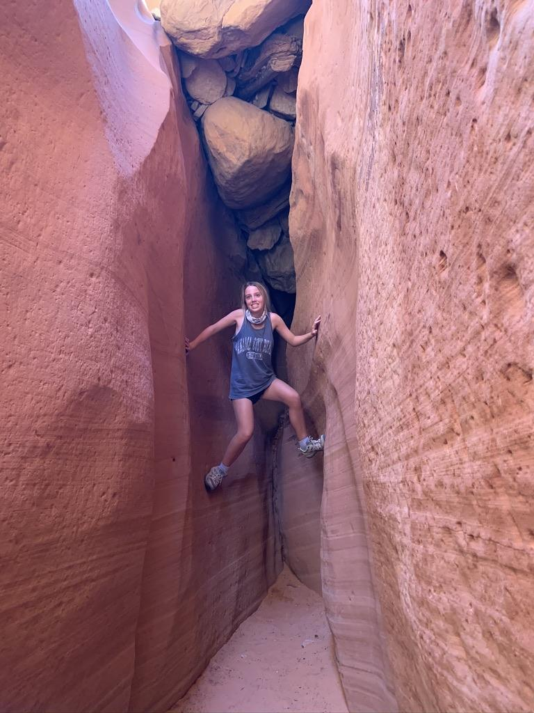
#6 FOCUS GROUPS
Virtual or in person a research method that brings together a small group of people to answer questions in a moderated setting.
Notes:
Virtual or in person a research method that brings together a small group of people to answer questions in a moderated setting.

Slide 27
CASE STUDY:
INDEPENDENT ELECTRICAL CONTRACTORS
Notes:
AMC (Innovatis Group); Micah is responsible for market research at the AMC; independent electrical contractors; how to connect member and partner communities through research; Milwaukee tools needs access to members in order to advance the products they want to release; continuum of research options but focus groups are fomed via virtual or at in-person events to give access to the members; 10-15K per focus group
And this gives members an opportunity to receive the research study results. This is a great perspective on how members from both sides of the fence can benefit from connecting through the association.

Slide 28
LET’S TALK:
FOCUS GROUPS
What is the staff intensity
of this initiative?
1 = Low Intensity
5 = High Intensity
Notes:
Staff intensity: 2 stars

Slide 29
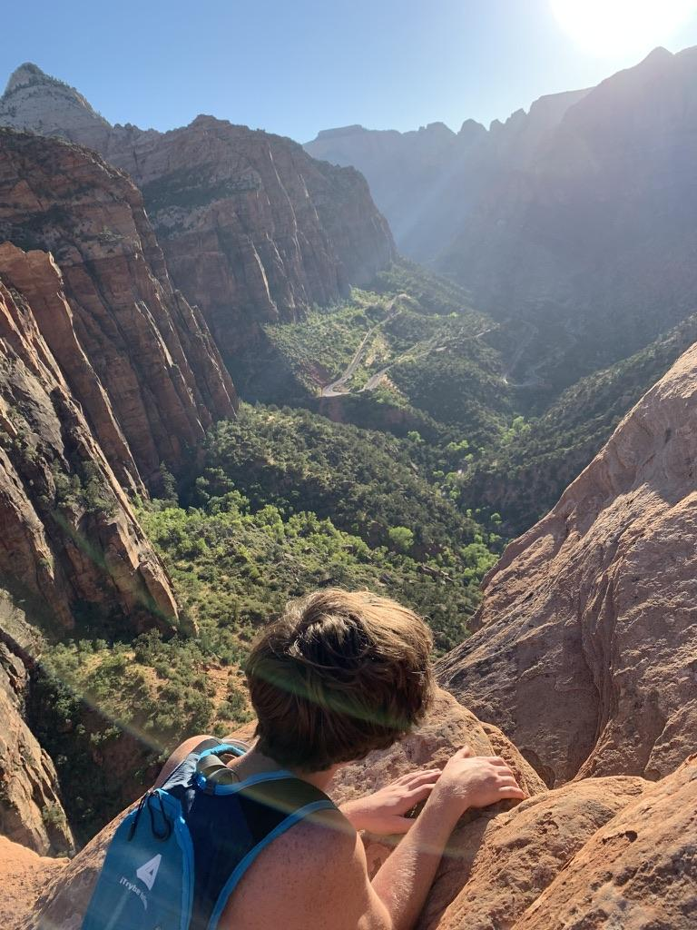
CREATE A PLAN THAT
WILL RESULT IN A PROFIT
Get Buy-In
Weigh Your Options
Estimate the Cost for Onboarding and Training
Calculate the Ongoing Maintenance
Make the Sales
Test the Concept
Adjust the Plan
Testify or Sunset
Notes:
Create a plan: who is involved, who will lead the project management; who will handle the ongoing management
Remember that sometimes you have to spend money to make new money
Onboarding and Training --
“An organization with 20% membership market penetration can easily sell into the other 80% (and make a credible claim to be a viable marketing channel to them to other firms who seek to sell to them) yet most associations choose to promote their products/services heavily only to their current members.”
Which programs are standing-room-only at your conferences? Focus your educational marketing efforts on your most in-demand programs—in demand by professionals and employers, both members and non-members. For example, a webinar on emerging trends featuring a compelling industry economist or futurist might attract both members and non-members. Give non-members a taste of your best. They’ll pay full price now but their educational ROI will persuade them to come back for more.

Slide 30
PRODUCT LIFECYCLE
The cost of doing too many small, unproductive projects is not the financial cost; it’s that you dilute and distract resources away from doing big, great things.
Notes:
Everything is subject to a product life cycle.
The cost of doing too many small, unproductive projects is not the financial cost; it’s that you dilute and distract resources away from doing big, great things.

Slide 31
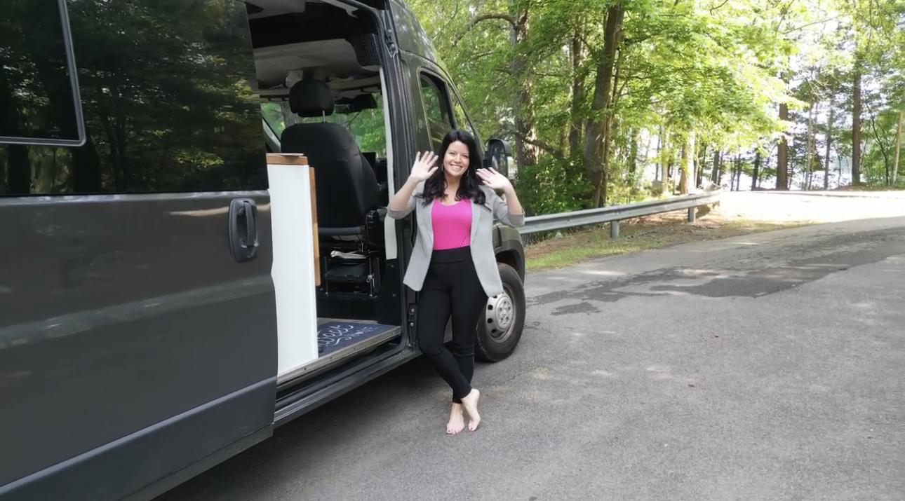


Always here to help.
Teri Carden
Creator & Strategist
Non Dues-a-Palooza
850-491-1390
teri@nonduesapalooza.com
“YOU DON’T HAVE TO BE GREAT TO START, BUT YOU HAVE TO START TO BE GREAT.”
ZIG ZIGGLER

