Slide 2
DeAnna Brown, FACMPE CPC
It’s great to be a Tennessee Vol!
Notes:
American War of 1848, when President James K. Polk of TN issued a call for 2,600 volunteers and 30,000 Tennesseans answered!

Slide 3
Who volunteers?
What makes a great volunteer?
Where do I find volunteers?
Why do they volunteer?
How do we prepare them for success?

Slide 4
Who Volunteers
Male
26.5%
Female
33.8%
$XXX,XXX
$XXX,XXX
Data obtained from americorps.gov

Slide 5
Who? Volunteers by Generation
Data obtained from americorps.gov

Slide 6
Engage the Generations
Gen Z
Social justice and equality
Flexible volunteer opportunities
Clear and concise calls to action
Digital platforms
Gen Y
Family Friendly Opportunities
Flexible volunteer opportunities
Organizational transparency
Regular updates on program process and how they have attributed
Gen X
Offer Mentorship
Foster Social Connections
Baby Boomers
Cultivate a sense of community
Offer accessible volunteer opportunities
Send regular emails and newsletter updates
Galaxydigital.com

Slide 7
Traits – What Makes A Great Volunteer
Professionalism
Passion
Strong work ethic
Teamwork
Time Management
Positive Attitude
Enthusiasm
Reliability
Servant attitude – willingness to serve
Believes in the organization and its mission.
Patience
Humility
Compassion
Creativity
Flexibility
Initiative
Cooperation
Leadership

Slide 8
Identifying Volunteers
Recruit
Train
Retain

Slide 9
Where do I find Volunteers?
Recruitment is all the time, every time, every opportunity
Call for volunteers at your events (that’s when they are excited and motivated)
Mentorship - Task your current leaders on the first day they take their position to find their replacement.
Local Chapter Leaders
Consistently look for members who are stepping up, leading, supporting the organization

Slide 10
Attracting A Volunteer
Why would they want to volunteer for your organization?
Create a culture that people want to be associated with.
Encourage people to step up.
Have fun
Create relationships and friends
Demonstrate your mission, values, and vision
People are always watching you…create something they want to be involved with!

Slide 11
Why Do People Volunteer?
It aligns with personal values
To learn
To develop their skills
To give back to certain people, organization, or community
Sense of duty
To build a resume
For experience

Slide 12
Identify….Interview….Offer
Nominating committee – Immediate Past President, Chair of Past Presidents, at least one other past president
Interview people for the position – why do they want to be on your executive board?
Share the job description with them including time commitments, travel expectations, and expenses
Look for people who want to give back to the organization not expect something back from it
Self growth is a positive side effect, but it shouldn’t be the goal. The goal is to make the organization better by developing the members.
Not everyone who wants to be on your board gets a seat at the table
Don’t be afraid or hesitant to remove someone from your board that isn’t supporting the vision and mission of your organization.
Data obtained from americorps.gove

Slide 13
How Do We Prepare Them for Success?
Create a safe environment for people to step out of their comfort zone and come out of their shell.
Mentorship
Face to Face Meetings
Formal onboarding and orientation
Job descriptions with timelines
Goals for the position and the organization
Structure
Code of Conduct
Mission Statement and Core Value review
History of the organization
Commitment agreement
Expense policy
Board Retreat
Formal Strategic Planning
Don’t make the position too onerous
Set expectations – be clear about their commitment and responsibilities
Hold everyone accountable

Slide 14
“You like each other”

Slide 15
We transform an organization,
that transforms the members,
that transforms US.

Slide 16
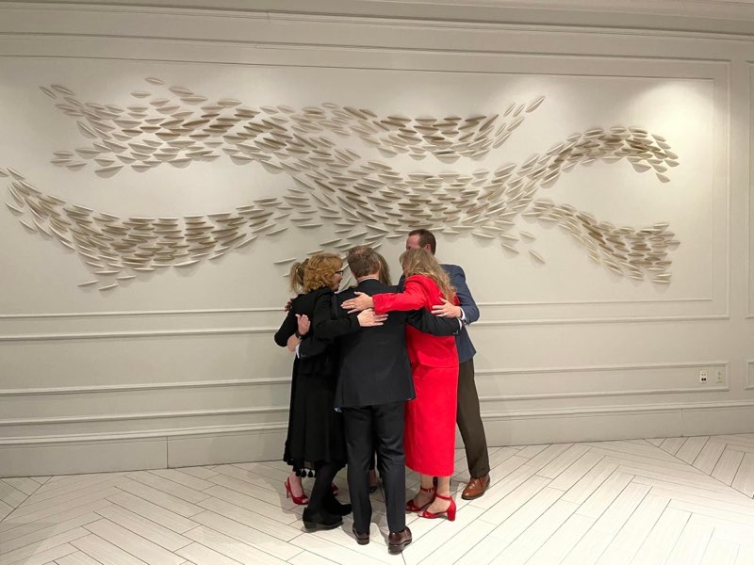
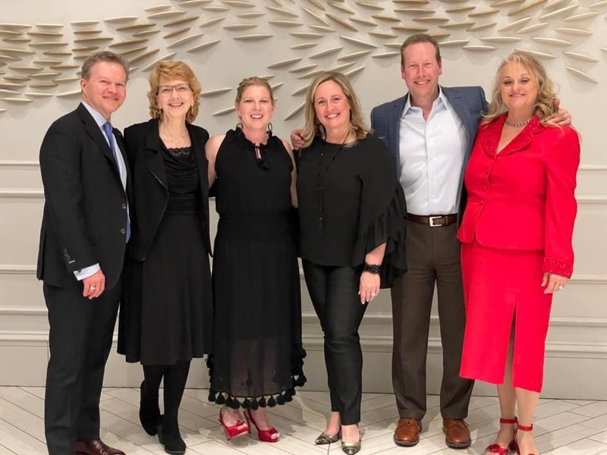
Volunteering created more than peers and confidants, it created FAMILY

Slide 17
In the End
Stay true to your mission, values, and vision of the organization.
Tennessee has a long history of being friendly, welcoming, and inclusive. If your organization isn’t already like that. It starts with you.
Have a genuine transparency about what it means to be volunteer and the importance of what it involves.
Good volunteers beget good volunteers.
If you’re board doesn’t click, people will see the difference in energy at your meetings and conferences.
People need to see what volunteering for your organization meant to you
They need to see that you enjoyed the time you served – Don’t be afraid to have fun
They need to see that you grew during your service
They need to see that you developed lasting relationships

Slide 20
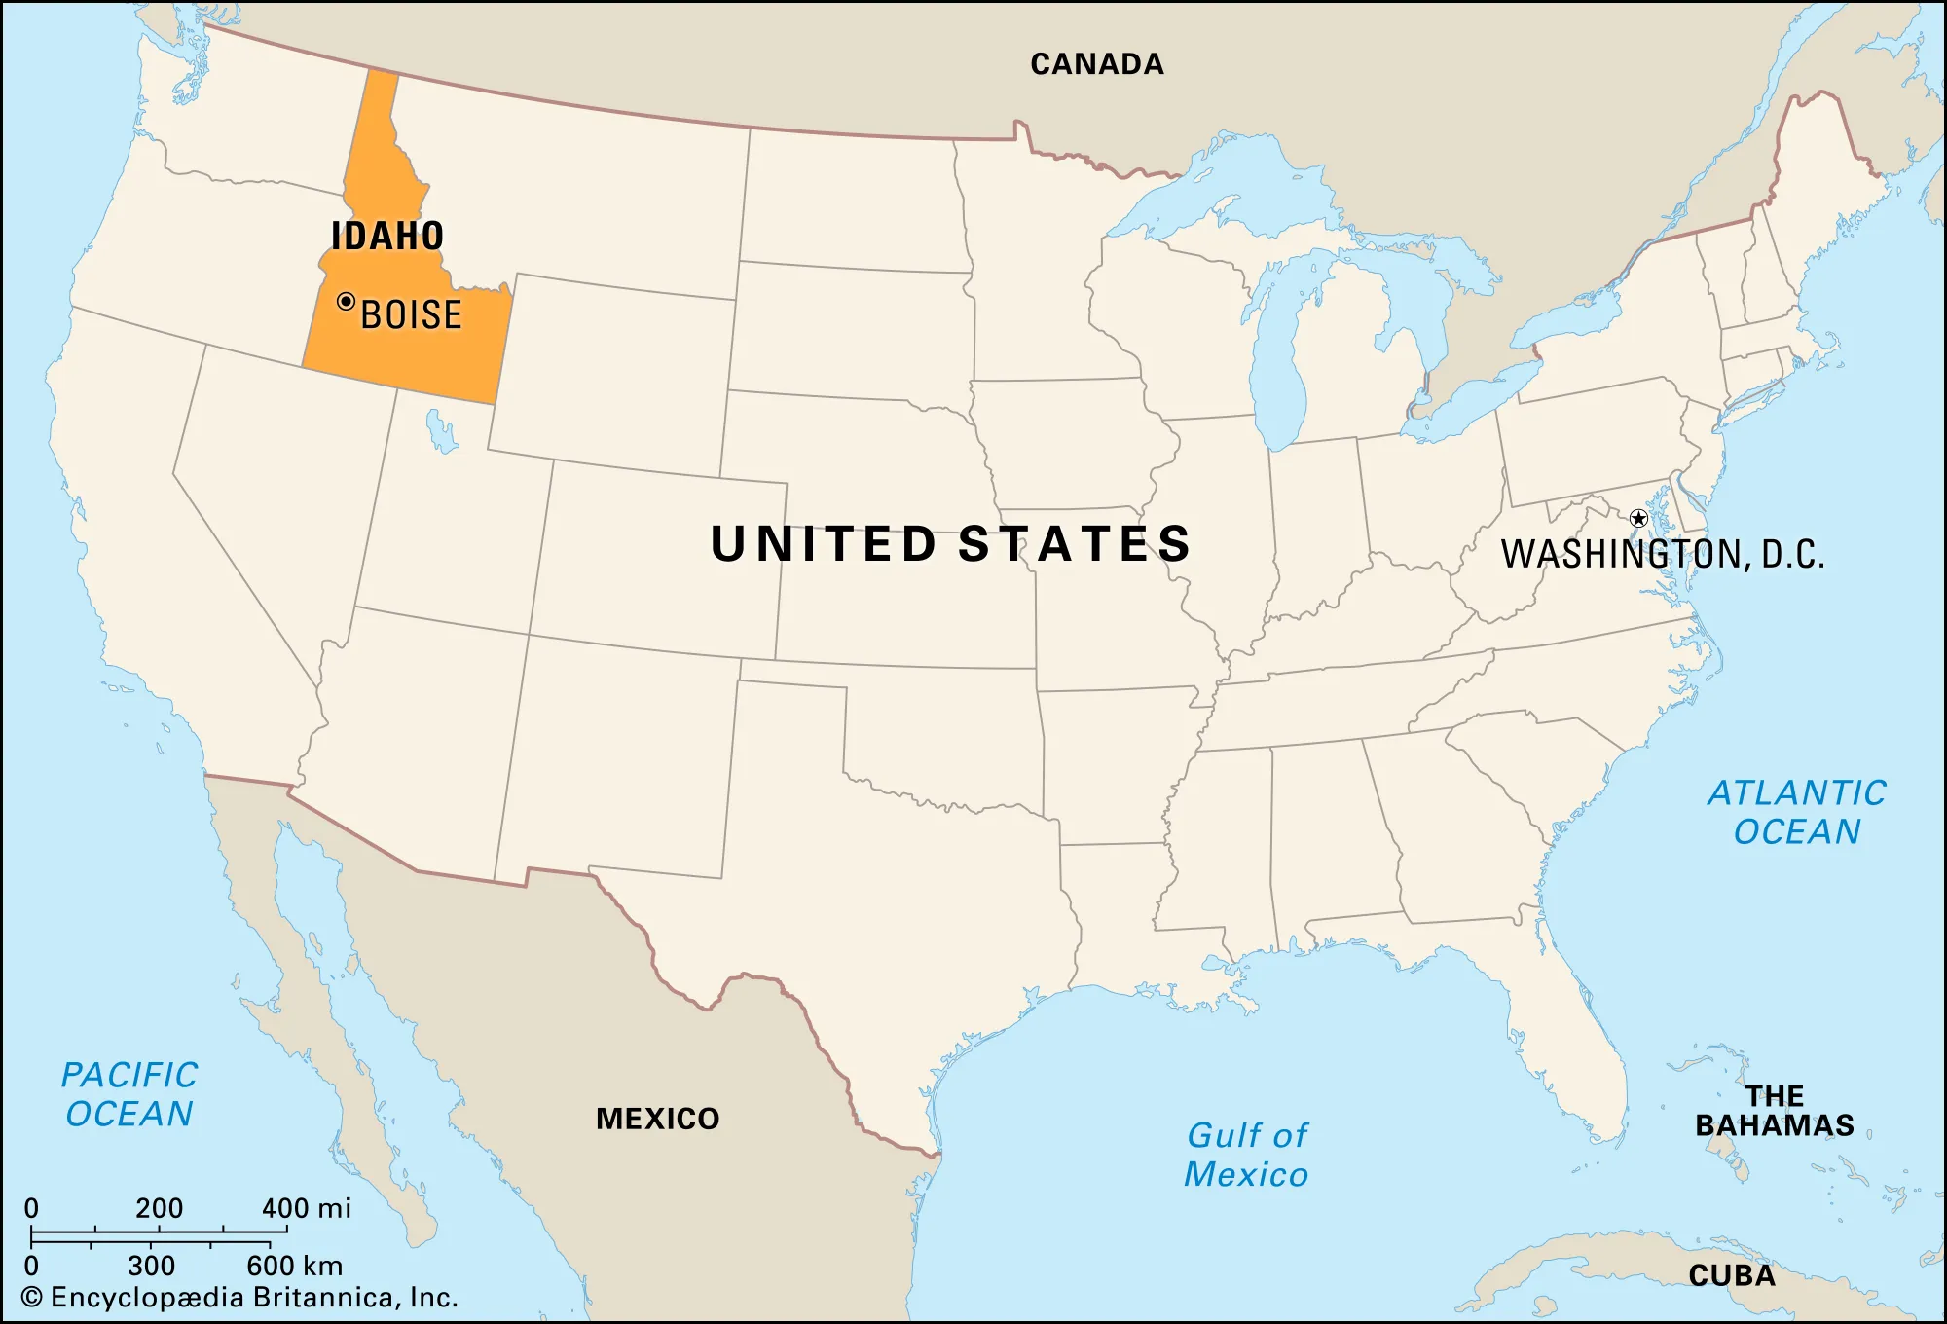
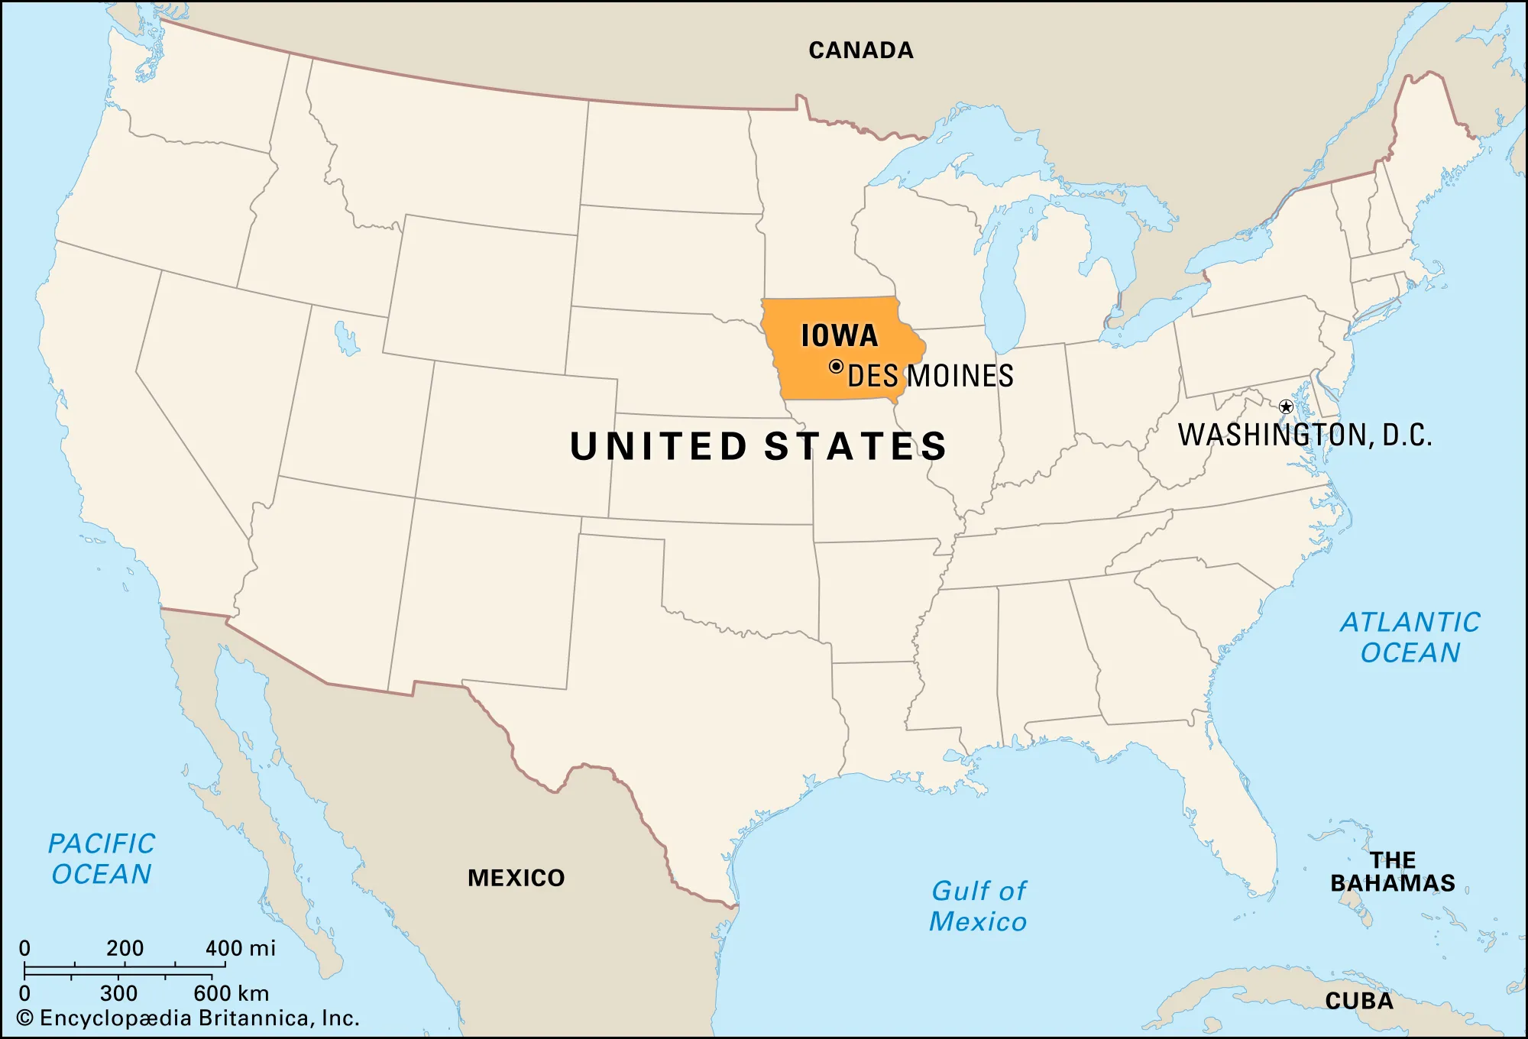

Slide 21
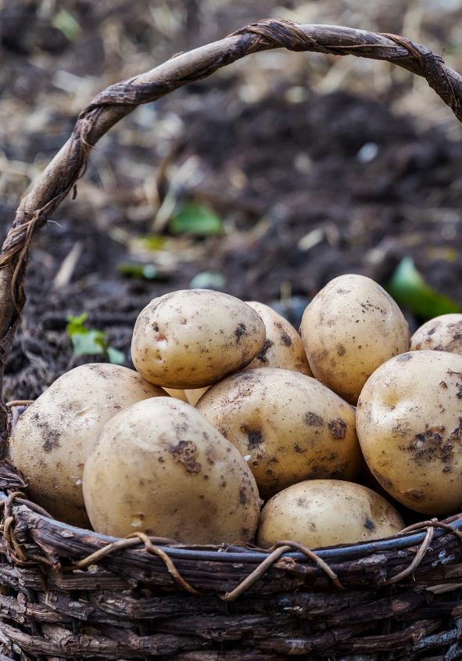
43rd State- become a state in 1890
Pacific North West (PNW)
Niagara Falls of the West (Shoshone Falls)
The “Gem” State
Most known for potatoes, Sun Valley, Coeur d’Alene, whitewater rafting/kayaking
Highest point is 12,662 ft
Population 1.9 Million
Notes:
1.9 Million Population 2021

Slide 22
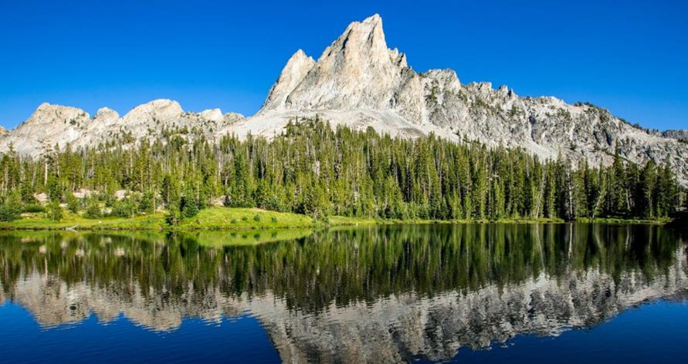
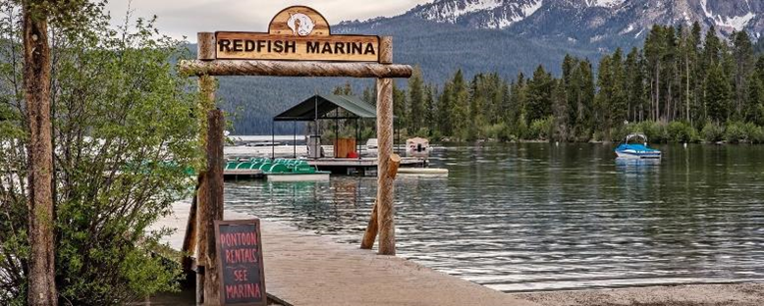
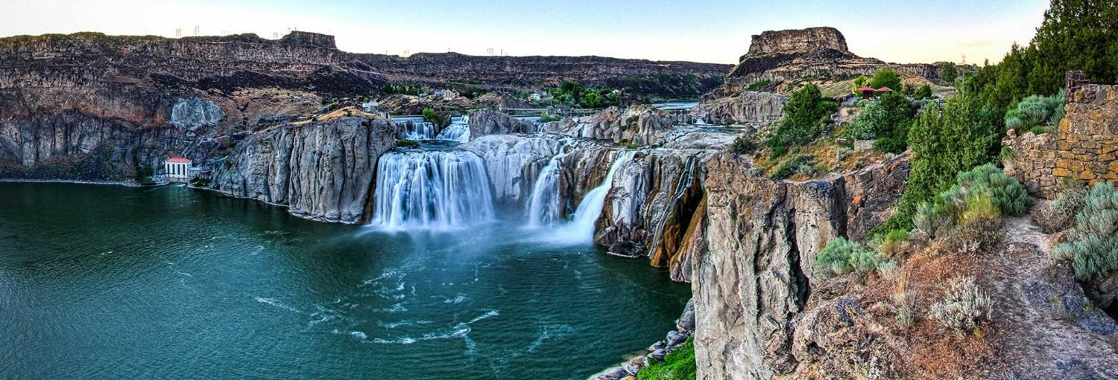
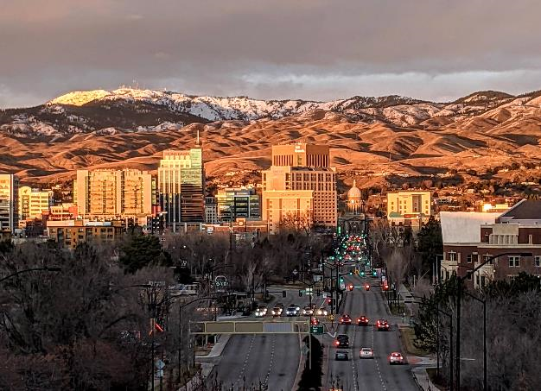
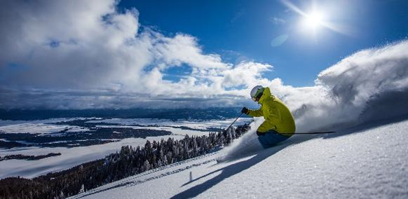

Slide 23
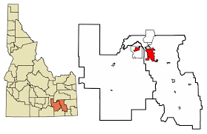
Meeting You Where You Are
Strategic Board Goal: 1-2 Social Event Outside of Boise Area
82% of Idaho MGMA members live in Boise area
We want to get to where our members are
6.5 % live in Region 4: Including Pocatello
Social event to get to know our members

Slide 24
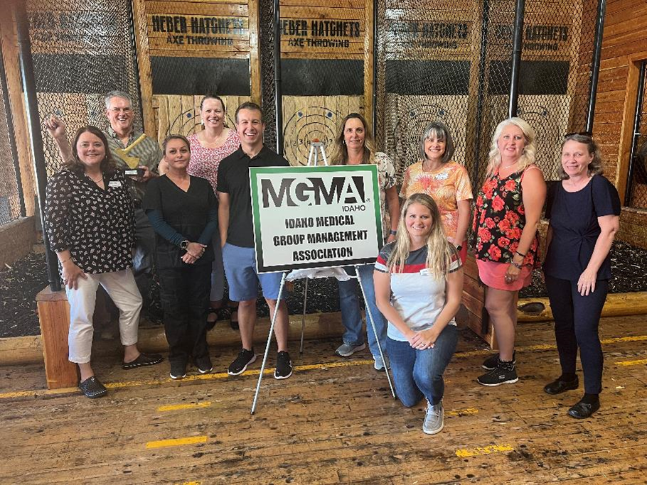
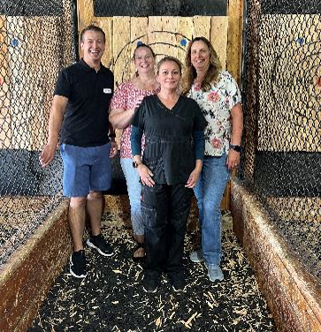
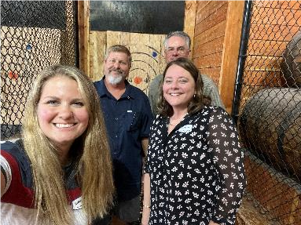
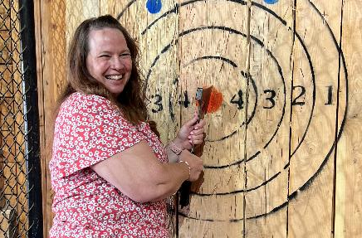

Slide 25
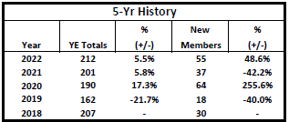
Increasing Membership Idaho MGMA
Setting the Stage
Membership fluctuated up and down during COVID years 2019-2022
Moved to predominantly on-line education/net-working meetings
Disruption in staff i.e. people moving, switching jobs
Organizations cutting costs
2022 membership director worked hard to increase membership over 200 members and was successful

Slide 26
Increasing Membership Idaho MGMA
Goal for 2023
• Reach a membership total count of 200
Obstacles:
- Organizations were cutting back due to cost
- Over 80% of the membership is from the central part of the state i.e. difficult to connect with other demographic areas of the state due to distance and convince of IMGMA’s value
- The majority of Treasure Valley medical clinics are owned by two large health systems
-11-the

Slide 27
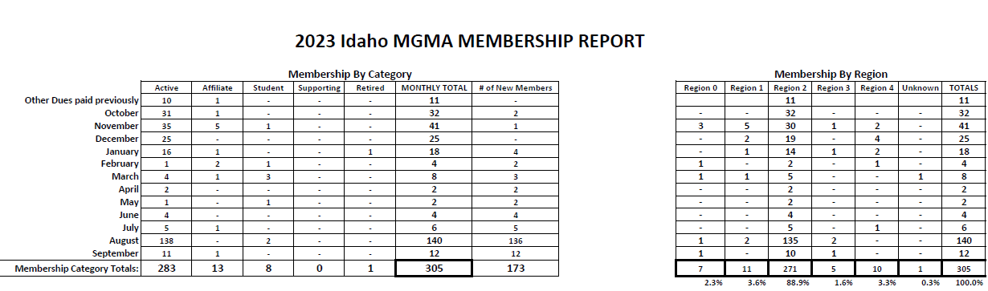
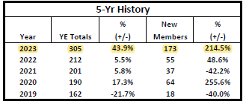

Slide 28
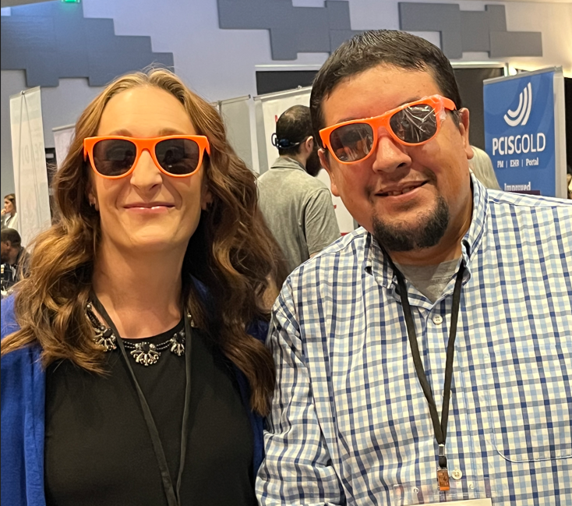
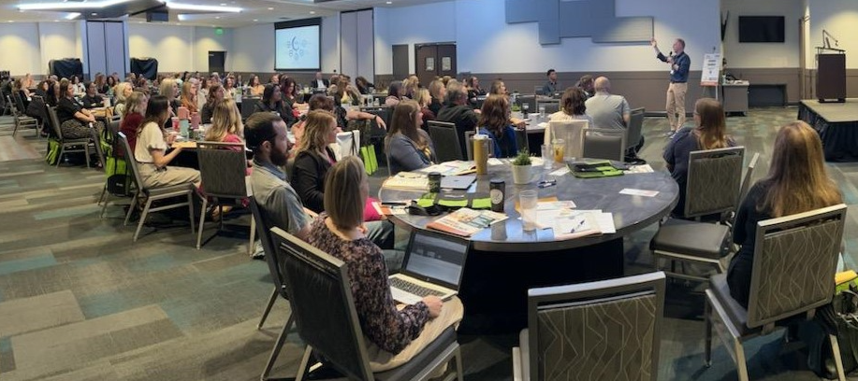
Success!!
305 members YTD
44% overall growth from the previous year

Slide 29
Key Tactics to increase membership
Tactics
Connect with Major Health Systems
Invited key leaders to be involved in the conference planning, develop relationships, and discussed how to get organization management/leaders more involved
Value to the organization
Memberships owned by the organization so transferable
Discounts for groups with large numbers
Domino effect
Promoted conference early with membership discounts and info on the value of membership
Personally welcome new members
Reaching groups outside Treasure Valley

Slide 30
Key Tactics to increase membership
Next Steps
Continue to keep new members engaged
Use the leverage to invite others in the state to join

Slide 31
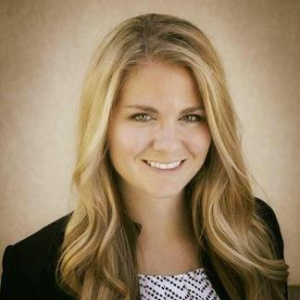
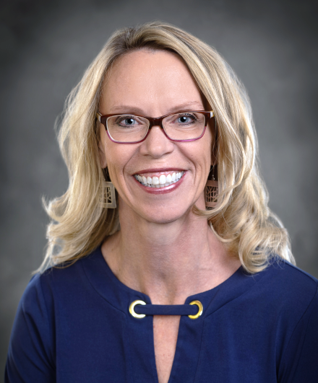
Contact Information
Laura Cradic, MBA, MHA
Nicole Bradshaw, MS, MBA(HC)
2023 Idaho MGMA President
Phone: 986-224-6675
Email: laura.cradic@bcidaho.com
2023 Idaho MGMA Membership Director
Phone: 208-880-5225
Email: nbradshaw@ogaidaho.com

